Slide 1
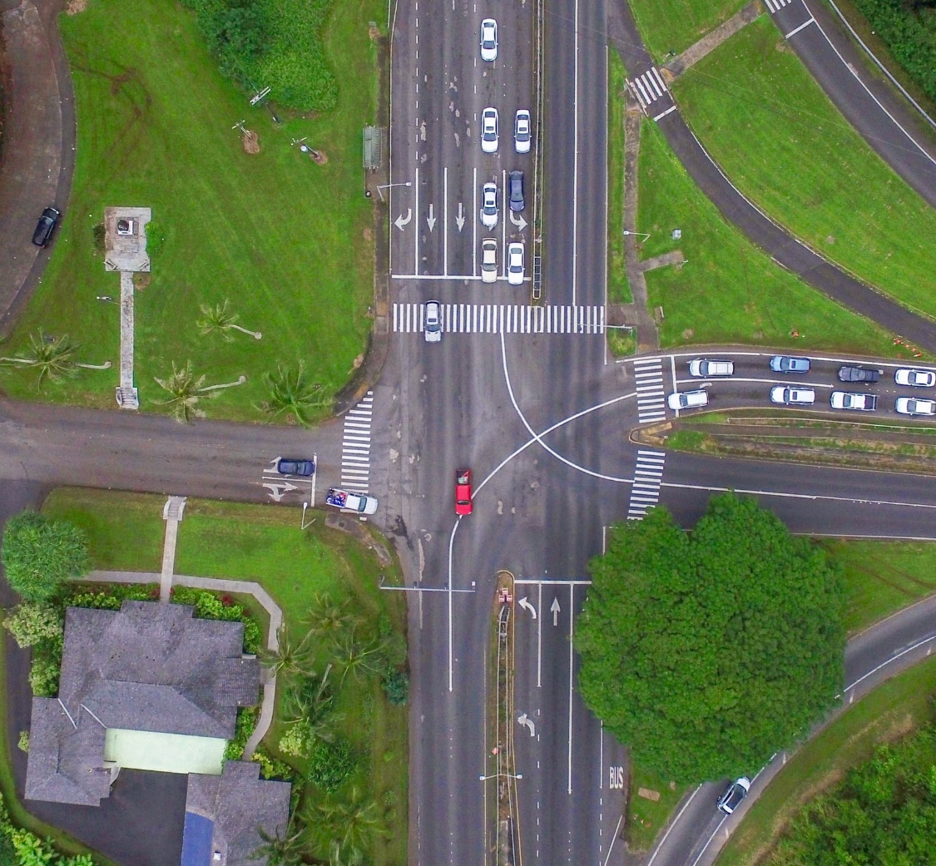
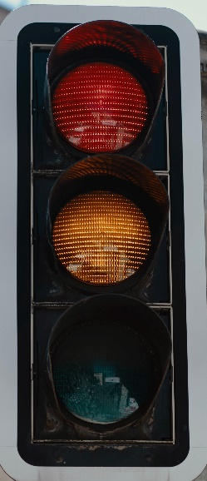
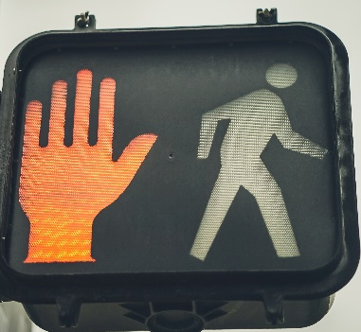
North-South TRAFFIC GO
Pedestrian Crossing DON'T WALK

Slide 2
North-South TRAFFIC SLOW
Pedestrian Crossing DON'T WALK

Slide 3
North-South TRAFFIC
STOP
Pedestrian Crossing WALK

Slide 4
North-South TRAFFIC
STOP
Pedestrian Crossing DON'T WALK

Slide 5
Green
Yellow
Red

Slide 6
North-South GREEN
Pedestrian Crossing DON'T WALK
East-West RED

Slide 7
North-South YELLOW
Pedestrian Crossing DON'T WALK
East-West RED

Slide 8
North-South RED
Pedestrian Crossing DON'T WALK
East-West GREEN

Slide 9
North-South RED
Pedestrian Crossing DON'T WALK
East-West YELLOW

Slide 10
North-South RED
Pedestrian Crossing WALK
East-West RED

Slide 11
Green
Yellow
Red

